Slide 1
提纲
SUMMARY四个标准
SUMMARY写作步骤
附件：UNIT 1,2,4 文章架构

Slide 2
SUMMARY 的四个标准：
An effective summary must meet the following four standards:
Completeness
■ To include all the major points of the original text
Originality
■ To use your own language instead of copying
Conciseness
■ To reveal the original text in a shorter passage
Objectivity
■ To follow the original text without personal ideas

Slide 3
SUMMARY 的写作步骤
仔细阅读文章：
弄清SUMMARY的写作目的：
是一般性的概括全文，还是为了回答某一个特定问题？
梳理文章的主体结构：
***参考“附件：UNIT 1,2,4 文章架构”
根据主体结构，从文中选出相关信息：
选出解释说明主体结构的文中信息 （见下一页）
根据文章主体结构、结合文中筛选的相关信息，写成完整句子和段落 （见下一页）
检查：语法是否准确；是否传达原文主旨；
行文是否流畅；逻辑是否清晰

Slide 4
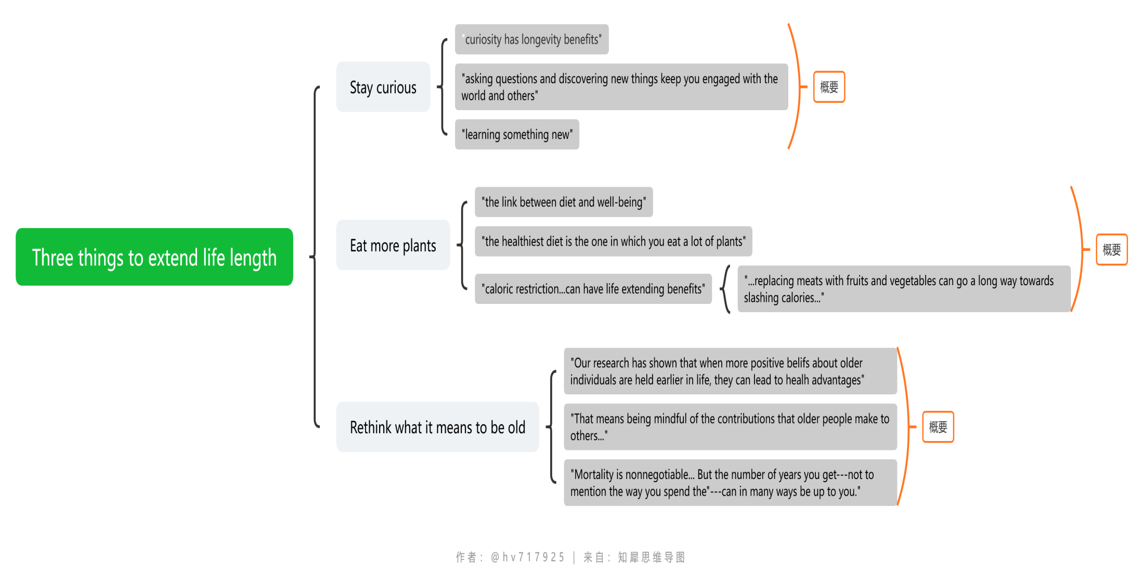
SUMMARY 的写作步骤：
例 Unit 4 Reading 1:
https://www.zhixi.com/view/a8e47b27

Slide 5
附件：UNIT 1,2,4 文章架构
Unit 1 Reading 1:
Problem-solution pattern:
Situation: Where the problem comes from (Para.1)
Campaign warning the cancer risk of potatoes
Problem: What is the problem (Para.2-6)
What is the problem--- Which foods contain acrylamide---Is acrylamide dangerous
Solution: How can the problem be solved (Para.7-12)
What should we do--- How else can we reduce the risk

Slide 6
附件：UNIT 1,2,4 文章架构
Unit 1 Reading 2
Problem-solution pattern:
Situation: Where does the problem come from? (Para.1)
The assumption that all processed foods are bad is NOT TRUE.
Problem: What is the problem? (Para.2)
How do we discern the difference between good and bad processed foods
Solution: What is the solution? (Para.3-11)
Clarification of food categories;
Specify which processed foods are good

Slide 7
附件：UNIT 1,2,4 文章架构
Unit 2 Reading 1:
General-specific pattern：
Situation: Background information: The Internet in history (Para.1).
General statement: The Internet will develop to be pervasive
(Para.2).
Specific statement 1: Wireless networks will be the primary access point for most devices (Para.3).
Specific statement 2: We will view the digital world in various ways (Para.4-5).
Specific statement 3: As the internet develops, privacy will disappear (Para.6).
Concluding statement: With the pervasive Internet, some questions are raised for further thinking.

Slide 8
附件：UNIT 1,2,4 文章架构
Unit 2 Reading 2:
General-specific pattern (Variety)：
Situation (Background of General statement):
The future of transportation with low carbon emission (Para.1-2)
General statement:
Combining the three vehicle techs can cut auto emissions. (Para.3)
Explanation on the general statement: (Para.4-12)
-Significance of the combining the three vehicle techs (Para.4-5) -How the combination of three vehicle techs cuts the carbon emission (Para.6-9)
-The effect of the combination (Para.10-12)
Concluding statement: (Para. 13-14)
-What else needs to be done on the government side+ the three techs is the only viable solution.

Slide 9
附件：UNIT 1,2,4 文章架构
Unit 4 Reading 1:
General-specific pattern：
Situation: Centenarians still represent a small proportion of the US population (Para.1)
General statement: Researchers suggest three things that can be done to start and keep doing to extend life length (Para.2).
Specific statement 1: Stay Curious + research evidence (Para. 3-4)
Specific statement 2: Eat way more plants than you think you need to+ research evidence (Para.5-9)
Specific statement 3: Rethink what it means to be old+ research evidence (Para.10-12)
Concluding statement: How to spend your life depends on you. (Para.13)

Slide 10
附件：UNIT 1,2,4 文章架构
Unit 4 Reading 2:
General-specific pattern (Variety)：
Situation: A woman lost weight by simply adjusting her meal time (Para.1).
General statement: Our body processes food differently at different time of a day (Para.2)
Explanation on general statement:
-Research evidence on the central argument (Para.3-4): Panda’s mice
-Explanation on the mechanism behind the central argument (Para.5-7)
--the correlation between meal timing and health;
circadian rhythm based on time; circadian rhythm based on food
-Suggestions based on the central argument (Para.8-11)
--Night fasting (Para.8-9);
Eating main meal earlier in the day (Para.10-11)

Slide 11
References
1.许宏晨《本科学术英语写作课程设计》PPT
2. UEFAP.COM SUMMARY
http://uefap.net/writing/writing-reporting/writing-reporting-summary

